Slide 1
Model Battery pack
CS229 Project – H2xML

Slide 2
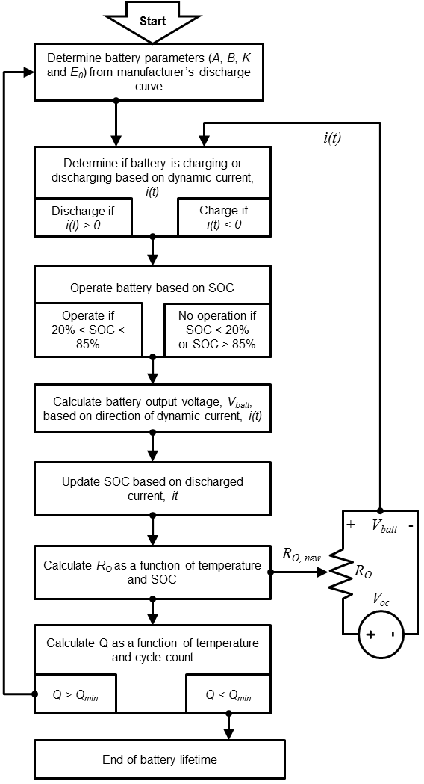
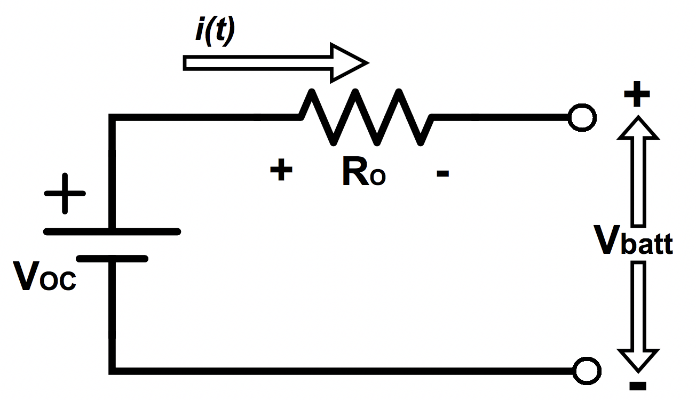
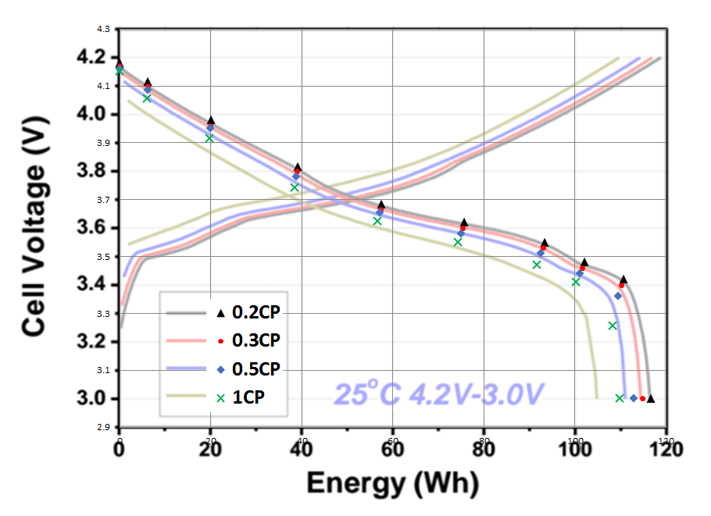
Presentation

Slide 3
Parameters , inputs and inputs of the model
Parameters
Capacity (A.h)
Charge/discharge characteristics
Round-cycle efficiency
Inputs
Initial battery load (SOC)
Environment Temperature
Outputs
Final battery load (SOC)

Slide 4
Modelling
I-V curves
SOC and SOH estimation
Constraint: min/max charge & discharge rates
Constraint: min/max charge & discharge

Slide 5
References
Battery energy storage applied to dispatch strategy, C. Goebel (2017)
https://ieeexplore.ieee.org/stamp/stamp.jsp?arnumber=7738562
Modelling stationary lithium-ion batteries, E. Raszmann (2017)
https://www.nrel.gov/docs/fy17osti/67809.pdf
Review of lithium-ion battery technologies and guide, D. Akinyele (2017)
https://www.mdpi.com/1996-1073/10/12/2107

